Slide 1
PosterJudge Plus Presentation
Ezekiel Motz
Gabriel Olmedo
John Gaddie II
Gaayathri Rayapaneni
Charles Carter

Slide 2
Basis For Project
Submission System for Students to submit posters to be added
Voting system for judges to give ratings to student posters
Assign the posters to judges arbitrarily to prevent biased results
Results are updated in the database after the judges evaluate the posters and give a score.
Scores will be available for students to view.

Slide 3
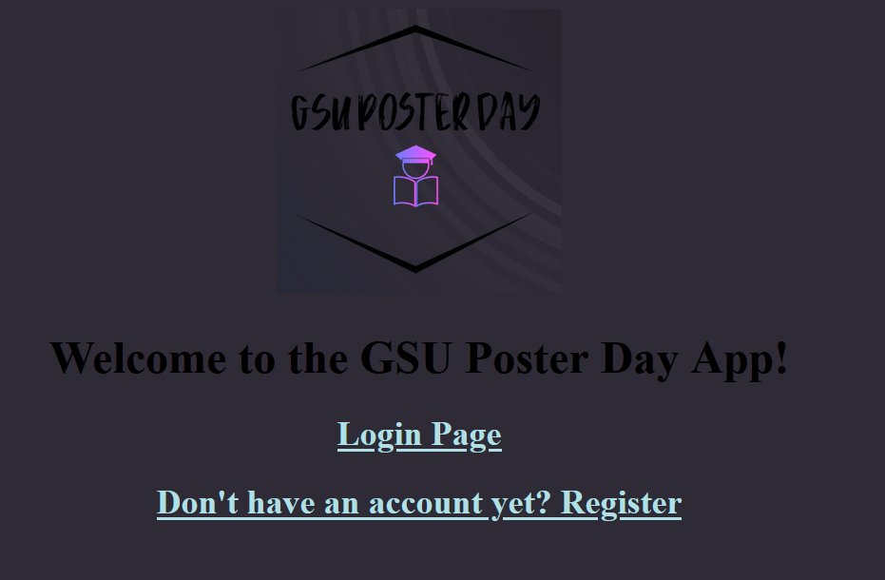
Front Page

Slide 4
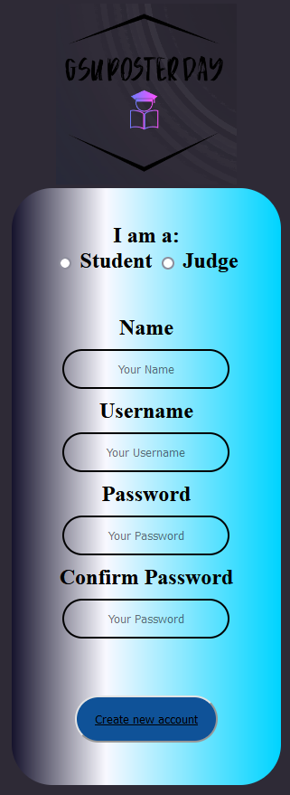
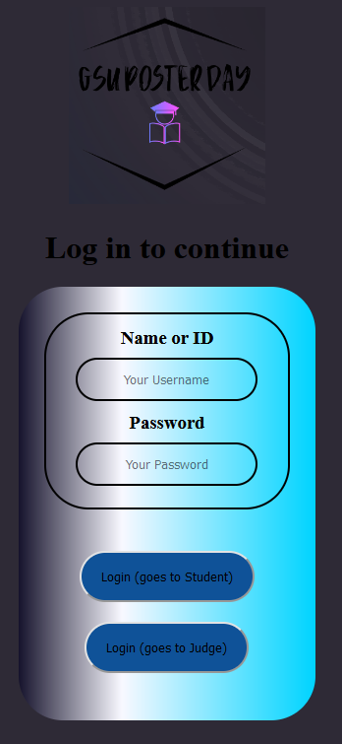
Register/Login Page
Users get the choice to either register or login
If registering, selection can be made between student or judge with a simple username and password creation template.
If login, user is asked for ID and Password. Two login buttons are for whether the user is a student or judge to be taken to their respective pages.

Slide 5
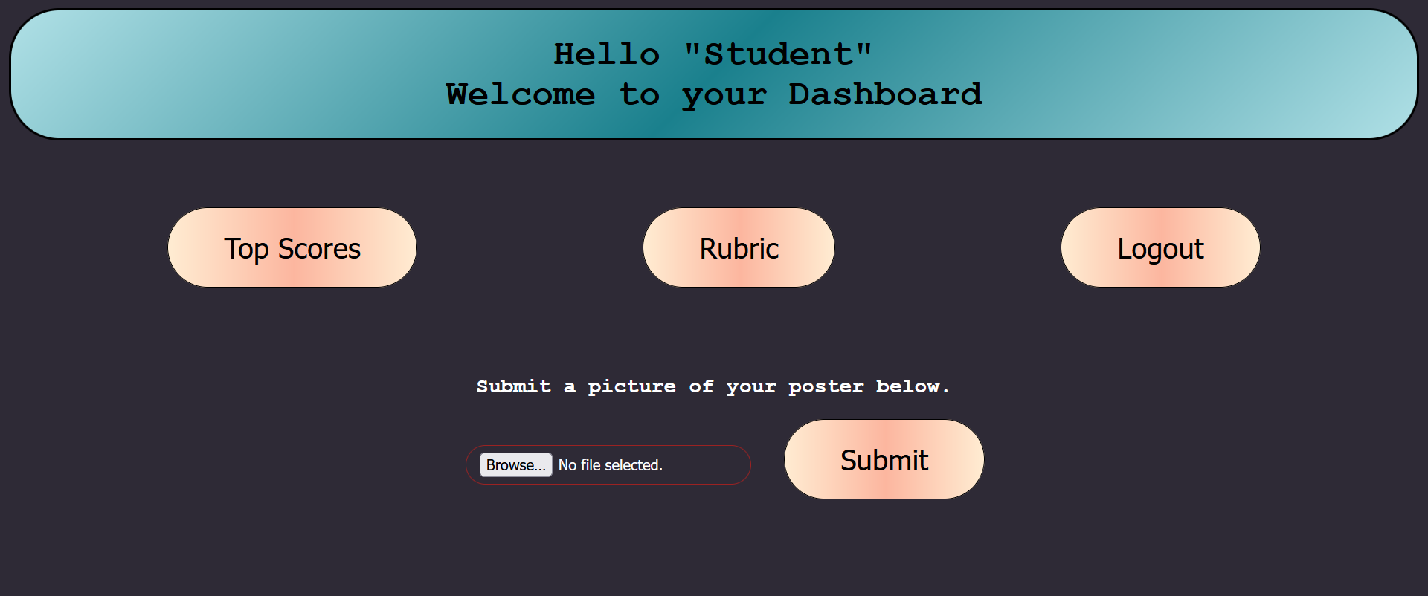
Dashboard “Student”
For students, the dashboard consists of four simple buttons.
Main one is the ‘Submit’ one where the user will be able to upload their respective posters to be submitted to the database
‘Top Scores’ will show scores from fellow students
‘Rubric’ will bring up the criteria judges follow whilst grading.
‘Logout’ does as it says and logs the user out.

Slide 6
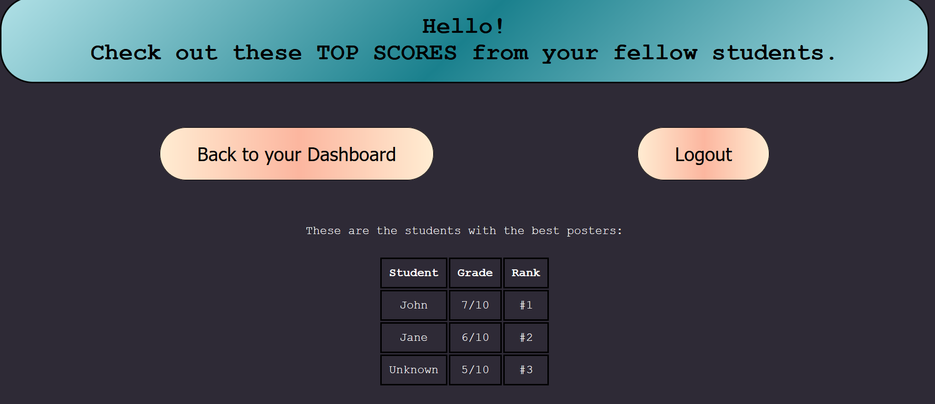
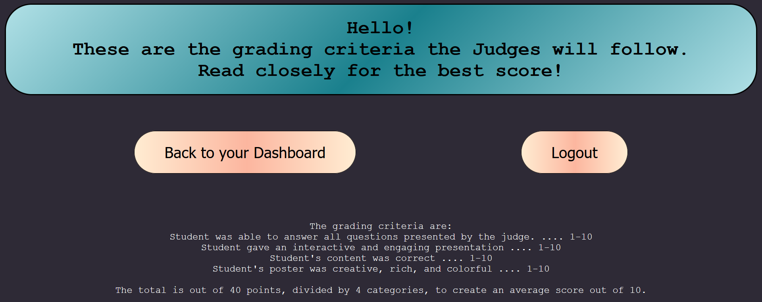
Dashboard ‘Student’

Slide 7
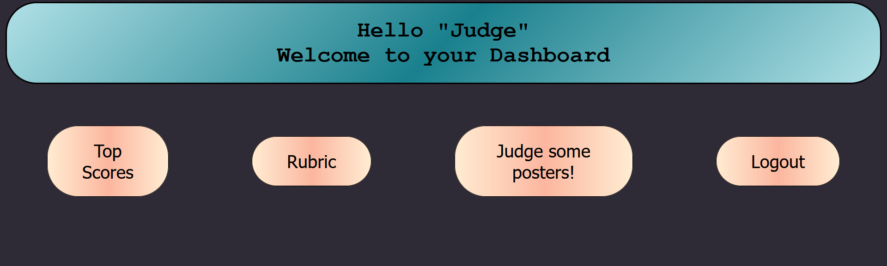
Dashboard ‘Judge’
For judges, the layout is similar to the student dashboard with the two exceptions of the removal of the poster submission button and the addition of the ‘Judge Some Posters’ button.
The latter button will take the judge to a new page to assign a rating to a student’s poster.

Slide 8
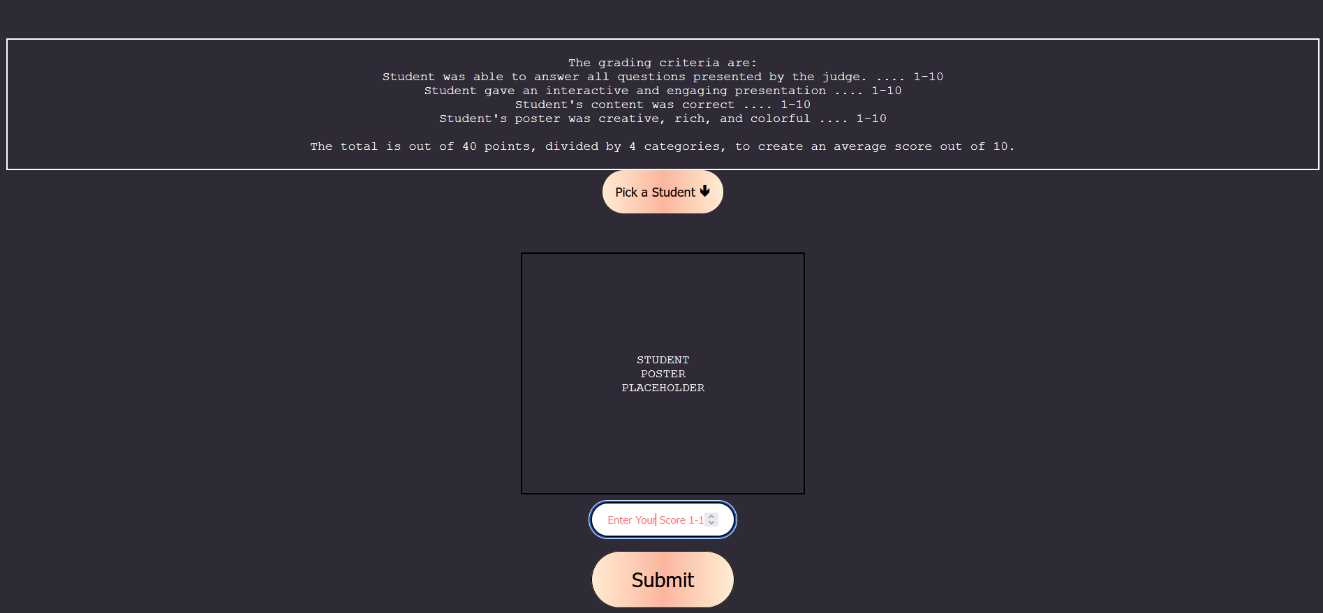
Dashboard ‘Judge’
The top gives the judge a reminder of the rubric for voting.
From the drop down menu they’ll be able to pick a student to judge.
The square displays the student’s poster (placeholder for now)
And below it they’ll be able to enter a score and submit their score.

Slide 9



Tech Stack
HTML/CSS - Frontend UI
Database - MySQL
Middleware/Scripts - Python

Slide 10
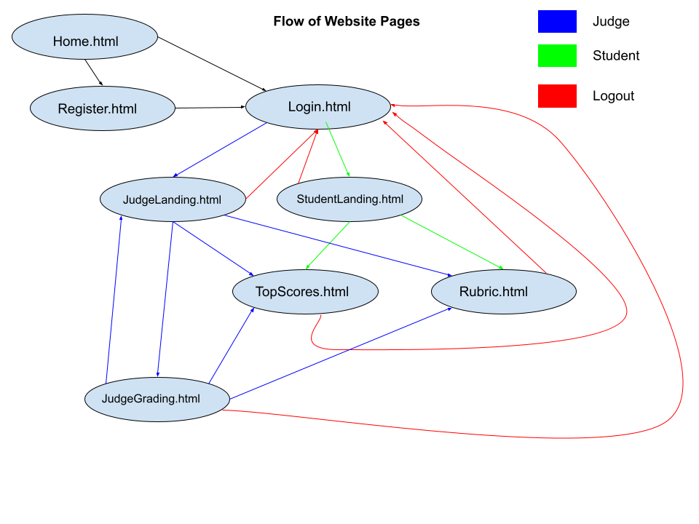

Slide 11
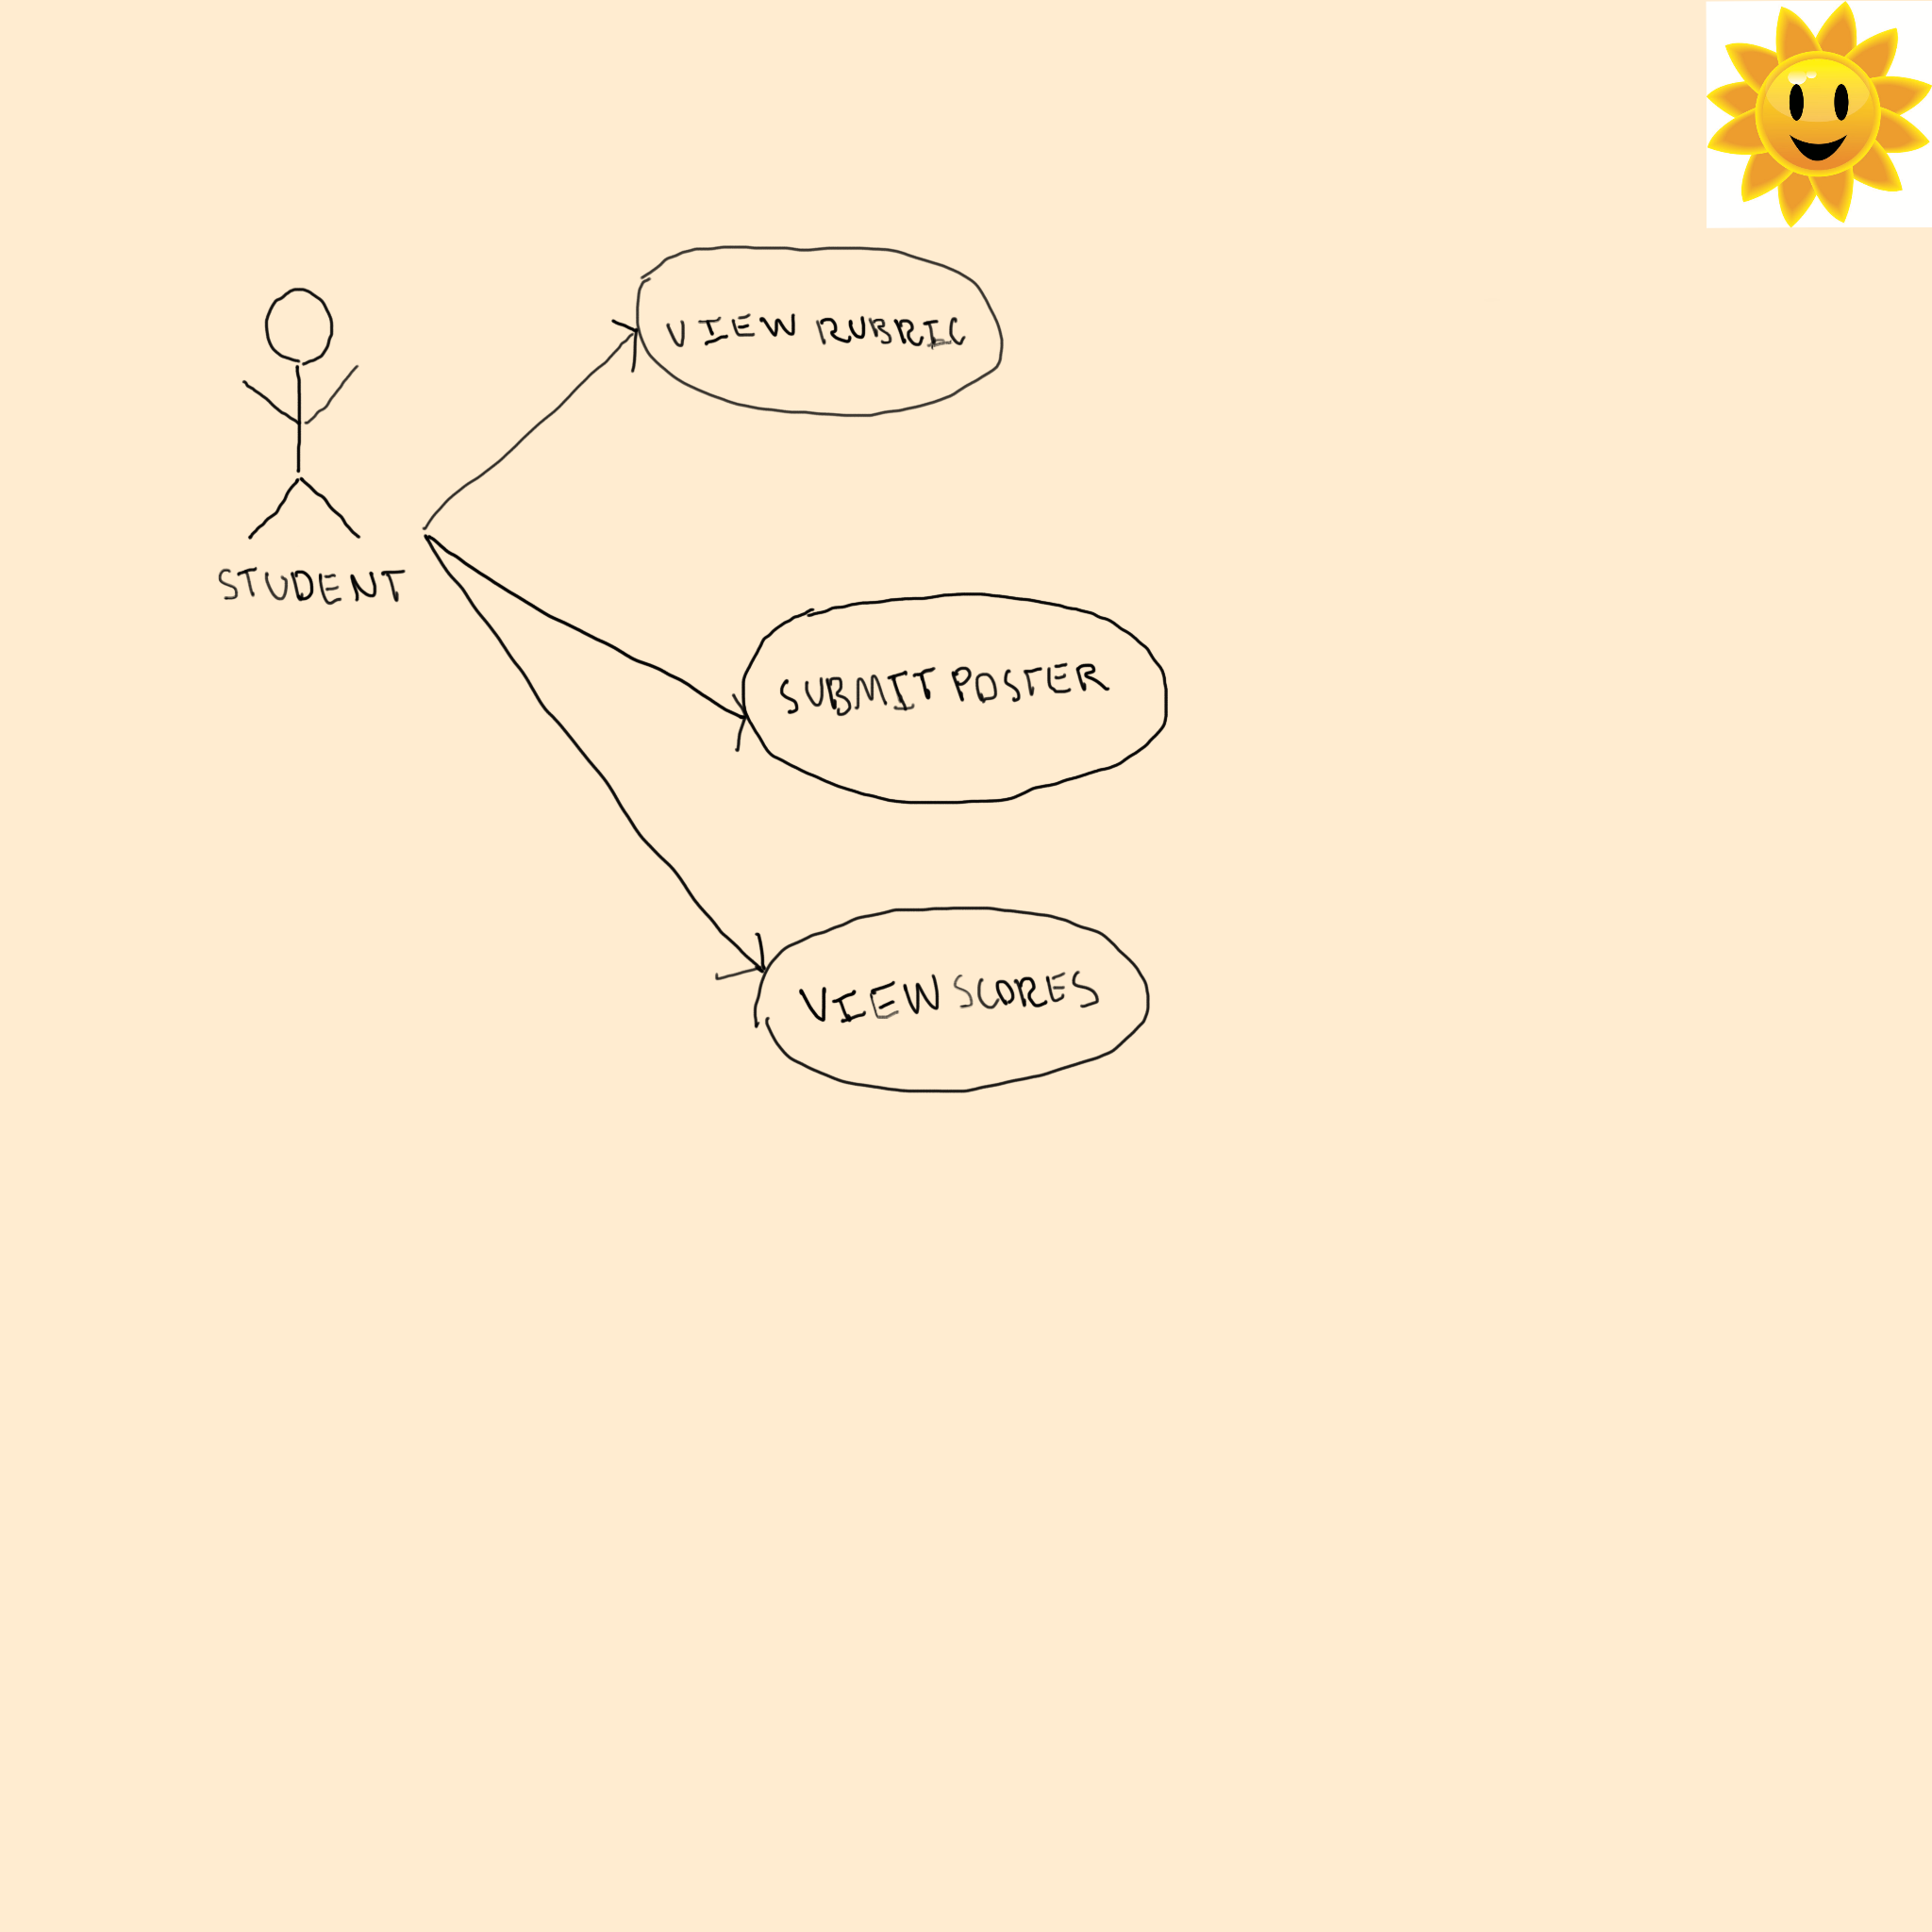

Slide 12
